Slide 1

Neural Networks II
Convolutional Neural Networks
Dr. Sugata Ghosal
CSIS Off Campus Faculty
BITS Pilani

Slide 2
In This Session
Introduction to Convolutional Networks
Fully Connected Layer
Convolution Layer
Edge Detector

Slide 3
Convolutional Neural Networks (CNN)
Special kind of neural network for processing data that has a known, grid-like topology.
e.g., Time-series data – 1D grid taking samples at regular time intervals.
e.g., Image data – 2D grid of pixels.
Network employs a mathematical operation called convolution.
Convolutional networks are simply neural networks that use convolution in place of general matrix multiplication in some of their layers.

Slide 4
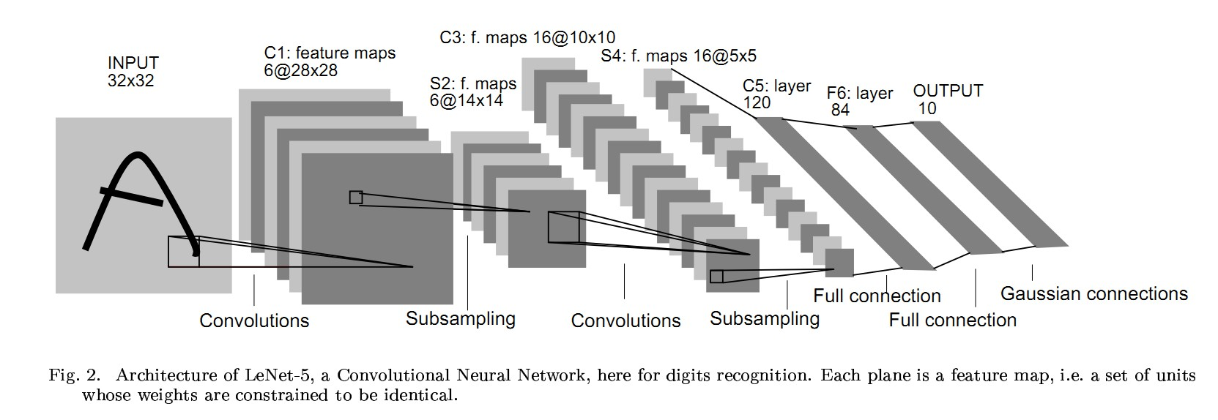
LeNet-5
Handwritten Character recognition 10-categories classification problem

Slide 5
Types of Layers
Convolution (Conv) Layer
Pooling (Pool) Layer
Fully Connected (FC) Layer

Slide 6
Convolution (Conv) Layer
Perform Convolution operation
Image
Kernel 5 × 5 × 3
Conv 1
Image
Input
n_{H} × n_{W} × n_{C}
Conv 1
(1) (1)
n × n × n
C
H W

Slide 7
Convolution Operation
Suppose we want to detect edges from an image.
The image will have vertical edges and horizontal edges.
Convolve the image with a kernel or filter to extract both the vertical edges and horizontal edges.
Input Size : n × n
Kernel Size : f × f
Ouput Size : (n − f + 1) × (n − f + 1)

Slide 8
Convolution Operation
Input Image 6 × 6
3 | 0 | 1 | 2 | 7 | 4
1 | 5 | 8 | 9 | 3 | 1
2 | 7 | 2 | 5 | 1 | 3
0 | 1 | 3 | 1 | 7 | 8
4 | 2 | 1 | 6 | 2 | 8
2 | 4 | 5 | 2 | 3 | 9
_{Kernel 3 × 3} Output Image 4 × 4
1 | 0 | -1
1 | 0 | -1
1 | 0 | -1
*
=

Slide 9
Convolution Operation
Input Image 6 × 6
3 | 0 | 1 | 2 | 7 | 4
1 | 5 | 8 | 9 | 3 | 1
2 | 7 | 2 | 5 | 1 | 3
0 | 1 | 3 | 1 | 7 | 8
4 | 2 | 1 | 6 | 2 | 8
2 | 4 | 5 | 2 | 3 | 9
_{Kernel 3 × 3} Output Image 4 × 4
1 | 0 | -1
1 | 0 | -1
1 | 0 | -1
*
=
value = 3(1) + 1(1) + 2(1) + 0(0) + 0(5) + 7(0) + 1(−1) + 8(−1) + 2(−1)
= −5

Slide 10
Convolution Operation
Input Image 6 × 6
3 | 0 | 1 | 2 | 7 | 4
1 | 5 | 8 | 9 | 3 | 1
2 | 7 | 2 | 5 | 1 | 3
0 | 1 | 3 | 1 | 7 | 8
4 | 2 | 1 | 6 | 2 | 8
2 | 4 | 5 | 2 | 3 | 9
_{Kernel 3 × 3} Output Image 4 × 4
-5
1 | 0 | -1
1 | 0 | -1
1 | 0 | -1
*
=
value = 0(1) + 5(1) + 7(1) + 1(0) + 8(0) + 5(0) + 2(−1) + 9(−1) + 5(−1)
= −4

Slide 11
Convolution Operation
Input Image 6 × 6
3 | 0 | 1 | 2 | 7 | 4
1 | 5 | 8 | 9 | 3 | 1
2 | 7 | 2 | 5 | 1 | 3
0 | 1 | 3 | 1 | 7 | 8
4 | 2 | 1 | 6 | 2 | 8
2 | 4 | 5 | 2 | 3 | 9
_{Kernel 3 × 3} Output Image 4 × 4
-5 | -4 | 0 | 8
-10 | -2 | -2 | 3
0 | -2 | -4 | -7
-3 | -2 | -3 | -16
1 | 0 | -1
1 | 0 | -1
1 | 0 | -1
*
=
value = 1(1) + 6(1) + 2(1) + 7(0) + 2(5) + 3(0) + 8(−1) + 8(−1) + 9(−1)
= −16

Slide 12





Fully Connected (FC) Layer
Stack of neurons in one layer is connected to every other neuron in another layer.
FC1 FC2 LR
yˆ₁

Slide 13
Vertical Edge Detector
Input Image 6 × 6
10 | 10 | 10 | 0 | 0 | 0
10 | 10 | 10 | 0 | 0 | 0
10 | 10 | 10 | 0 | 0 | 0
10 | 10 | 10 | 0 | 0 | 0
10 | 10 | 10 | 0 | 0 | 0
10 | 10 | 10 | 0 | 0 | 0
_{Kernel 3 × 3} Output 4 × 4
0 | 30 | 30 | 0
0 | 30 | 30 | 0
0 | 30 | 30 | 0
0 | 30 | 30 | 0
1 | 0 | -1
1 | 0 | -1
1 | 0 | -1
*
=

Slide 14


Horizontal Edge Detector
Input Image 6 × 6
10 | 10 | 10 | 10 | 10 | 10
10 | 10 | 10 | 10 | 10 | 10
10 | 10 | 10 | 10 | 10 | 10
0 | 0 | 0 | 0 | 0 | 0
0 | 0 | 0 | 0 | 0 | 0
0 | 0 | 0 | 0 | 0 | 0
_{Kernel 3 × 3} Output 4 × 4
0 | 0 | 0 | 0
30 | 30 | 30 | 30
30 | 30 | 30 | 30
0 | 0 | 0 | 0
1 | 1 | 1
0 | 0 | 0
-1 | -1 | -1
*
=

Slide 15
Edge Detectors
Similarly edge at 45◦, 60◦ and all can be detected, by appropriately choosing the kernels or filters.
Then stack the different filters to obtain edges.
The aim of the Convolution layer will be learn the filter or kernel matrix.
The NN will learn the 9 weights in the filter.
Filter 3 × 3
w₁ | w₂ | w₃
w₄ | w₅ | w₆
w₇ | w₈ | w₉

Slide 16

Padding, Striding, Pooling

Slide 17
Neural Networks II
Padding, Striding, Pooling
Dr. Sugata Ghosal
CSIS Off Campus Faculty
BITS Pilani

Slide 18
In This Session
Padding
Striding
Pooling
Max Pooling
Average Pooling

Slide 19
Convolution Operation
Input Image 6 × 6
3 | 0 | 1 | 2 | 7 | 4
1 | 5 | 8 | 9 | 3 | 1
2 | 7 | 2 | 5 | 1 | 3
0 | 1 | 3 | 1 | 7 | 8
4 | 2 | 1 | 6 | 2 | 8
2 | 4 | 5 | 2 | 3 | 9
_{Kernel 3 × 3} Output Image 4 × 4
-5 | -4 | 0 | 8
-10 | -2 | -2 | 3
0 | -2 | -4 | -7
-3 | -2 | -3 | -16
1 | 0 | -1
1 | 0 | -1
1 | 0 | -1
*
=

Slide 20
Padding
When filter is convolved with the input image
⁾ Image shrinks – 6 × 6 image became a 4 × 4 image.
⁾ Pixels in the corners are used only once, when compared the pixels in the middle. The data in the corners are thrown away.
To resolve, apply padding to the input image before convolution. Padding means append zeros around the boundary of the input.

Slide 21
Convolution with Padding
Input Image with padding 8 × 8
0 | 0 | 0 | 0 | 0 | 0 | 0 | 0
0 | 3 | 0 | 1 | 2 | 7 | 4 | 0
0 | 1 | 5 | 8 | 9 | 3 | 1 | 0
0 | 2 | 7 | 2 | 5 | 1 | 3 | 0
0 | 0 | 1 | 3 | 1 | 7 | 8 | 0
0 | 4 | 2 | 1 | 6 | 2 | 8 | 0
0 | 2 | 4 | 5 | 2 | 3 | 9 | 0
0 | 0 | 0 | 0 | 0 | 0 | 0 | 0
Kernel 3 × 3
*
1 | 0 | -1
1 | 0 | -1
1 | 0 | -1

Slide 22
Padding
Two kinds of padding
⁾ Valid Padding
^{Ç} Padding is not applied.
p = 0
^{Ç} Input size ƒ= output size.
^{Ç} Output shrinks when compared to the input.
⁾ Same Padding
^{Ç} Padding is applied.
_{p =} f − 1
2
^{Ç} Input size = output size.
^{Ç} We maintain the size of input and output as the same.

Slide 23
Padding
How much to pad?
Padding : p = ^{f -1}
2
Kernel 3 × 3 : p = 1
Kernel 5 × 5 : p = 2
Kernel 7 × 7 : p = 3
Padding preserves the input size.
Input Size : n × n
Padding : p
Kernel Size : f × f
Ouput Size : (n + 2p − f + 1) × (n + 2p − f + 1)

Slide 24
Striding
Skip by how many pixels.
Input Size : n × n
Padding : p
Stride : s
Kernel Size : f × f
, , , ,
n + 2p − f ₊ ₁ n + 2p − f ₊ ₁
Ouput Size :
×
s
s
The filter must lie completely inside the input.

Slide 25
Convolution with Stride
Input Image 7 × 7
2 | 4 | 7 | 4 | 6 | 2 | 9
6 | 6 | 9 | 8 | 7 | 4 | 3
3 | 4 | 8 | 3 | 8 | 9 | 7
7 | 8 | 3 | 6 | 6 | 3 | 4
4 | 2 | 1 | 8 | 2 | 4 | 6
3 | 2 | 4 | 1 | 9 | 8 | 3
0 | 1 | 3 | 9 | 2 | 1 | 4
Kernel 3 × 3
Stride = 2
Output 3 × 3
91
*
3 | 4 | 4
1 | 0 | 2
-1 | 0 | 3
=

Slide 26
Convolution with Stride
Input Image 7 × 7
2 | 4 | 7 | 4 | 6 | 2 | 9
6 | 6 | 9 | 8 | 7 | 4 | 3
3 | 4 | 8 | 3 | 8 | 9 | 7
7 | 8 | 3 | 6 | 6 | 3 | 4
4 | 2 | 1 | 8 | 2 | 4 | 6
3 | 2 | 4 | 1 | 9 | 8 | 3
0 | 1 | 3 | 9 | 2 | 1 | 4
Kernel 3 × 3
Stride = 2
Output 3 × 3
91 | 100
*
3 | 4 | 4
1 | 0 | 2
-1 | 0 | 3
=

Slide 27
Convolution with Stride
Input Image 7 × 7
2 | 4 | 7 | 4 | 6 | 2 | 9
6 | 6 | 9 | 8 | 7 | 4 | 3
3 | 4 | 8 | 3 | 8 | 9 | 7
7 | 8 | 3 | 6 | 6 | 3 | 4
4 | 2 | 1 | 8 | 2 | 4 | 6
3 | 2 | 4 | 1 | 9 | 8 | 3
0 | 1 | 3 | 9 | 2 | 1 | 4
Kernel 3 × 3
Stride = 2
Output 3 × 3
91 | 100 | 83
69 | 91 | 127
44 | 72 | 74
*
3 | 4 | 4
1 | 0 | 2
-1 | 0 | 3
=

Slide 28
One Layer CNN
Relu W +
b
Kernel 1
3 × 3 × 3
Conv
4 × 4 × 2
Image 6 × 6 × 3
Relu W +
b
Kernel 2
3 × 3 × 3

Slide 29
Number of Parameters
The number of parameters depend on the number of kernels and the kernel size.
Kernel : f × f ∗ n_{C}
Bias : 1
# Parameters : f ∗ f ∗ n_{C}
# Parameters : 3 ∗ 3 ∗ 3 + 1 = 28
2 kernels : 28 ∗ 2 = 56
per kernel

Slide 30
Pooling (Pool) Layer
Used for subsampling
Reduce the size of representation
Speed up computation

Slide 31
Pooling
Apply a filter of size f and stride s without padding.
The output dimensions will be
, , ,
,
n − f
n − f
+ 1 × + 1
s s
Fixed computation
Gradient descent is not applied as no learnable parameters
Pooling is applied on each of the channels.

Slide 32
Pooling Layer
Two types
Max Pooling
Average Pooling

Slide 33
Max Pooling
Take the maximum of the sub region that is considered.
Input 4 × 4 _{Output}
2 | 4 | 7 | 4
6 | 6 | 9 | 8
3 | 4 | 8 | 3
7 | 5 | 3 | 6
Max pooling
→ f = 2 →
s = 2
2 × 2
6 | 9
7 | 8

Slide 34
Average Pooling
Compute the average of the sub region that is considered.
Input 4 × 4 _{Output}
2 | 4 | 7 | 4
6 | 6 | 9 | 8
3 | 4 | 8 | 3
7 | 5 | 3 | 6
Average pooling
f = 2
s = 2
2 × 2
→
→
4.5 | 7
4.75 | 5

Slide 35
Variants of CNN

Slide 36
Neural Networks II
Architectures for Classification
Dr. Sugata Ghosal
CSIS Off Campus Faculty
BITS Pilani

Slide 37
In This Session
LeNet-5
AlexNet
VGG 16
Resnet
Inception
Transfer Learning

Slide 38
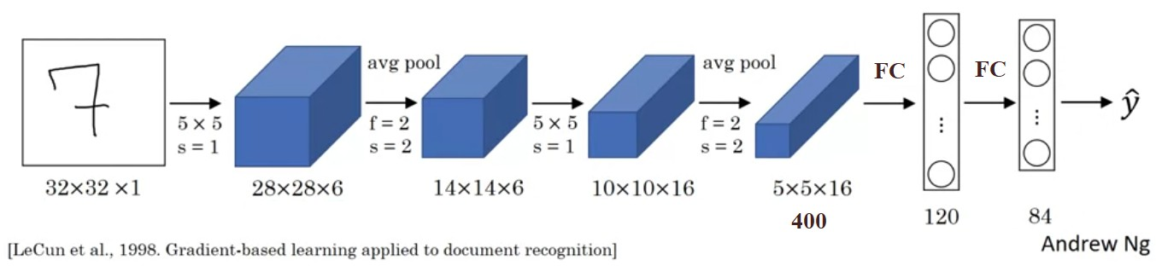
LeNet-5
Handwritten Character recognition 10-categories classification problem
Approx. 60 thousand parameters are learned.

Slide 39
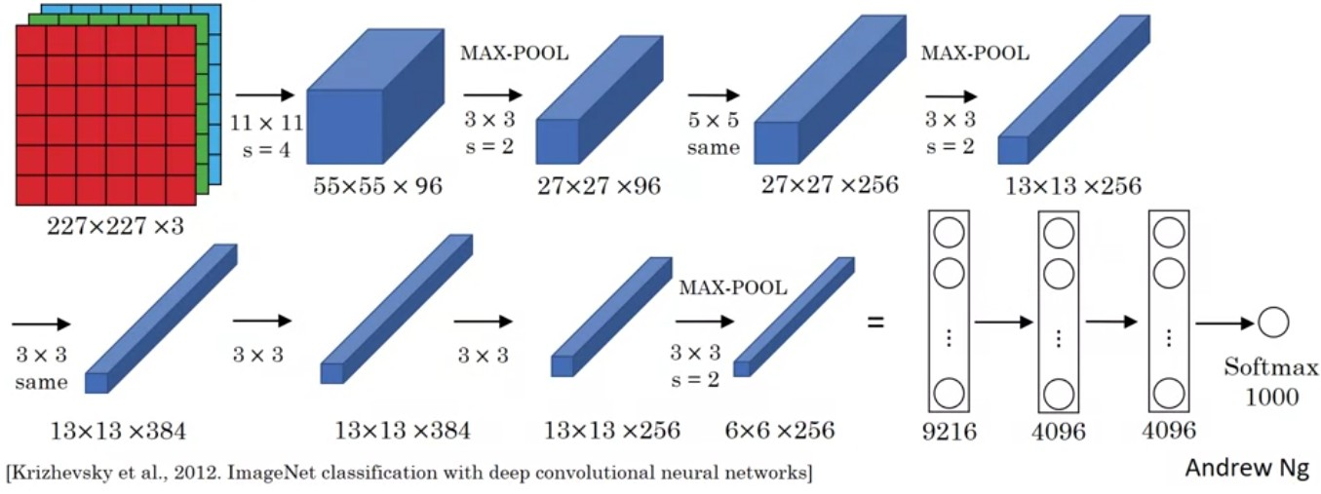
AlexNet
ImagetNet dataset
1000-categories classification problem
Approx. 60 million parameters are learned.

Slide 40
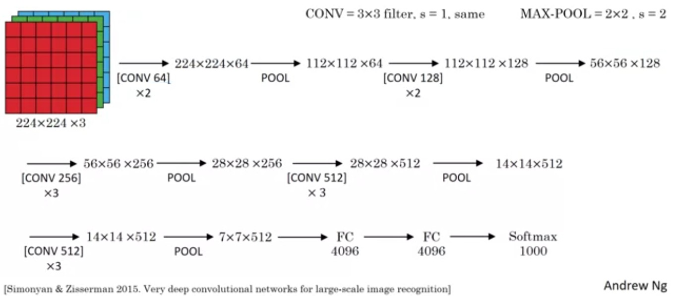
VGG 16
16 Layers
Approx. 138 million parameters are learned.

Slide 41
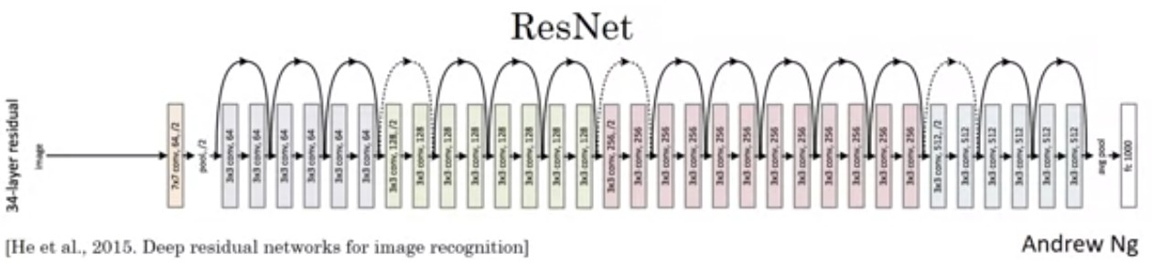
ResNet
Residual block as a shortcut
Reduces the impact of vanishing gradients

Slide 42
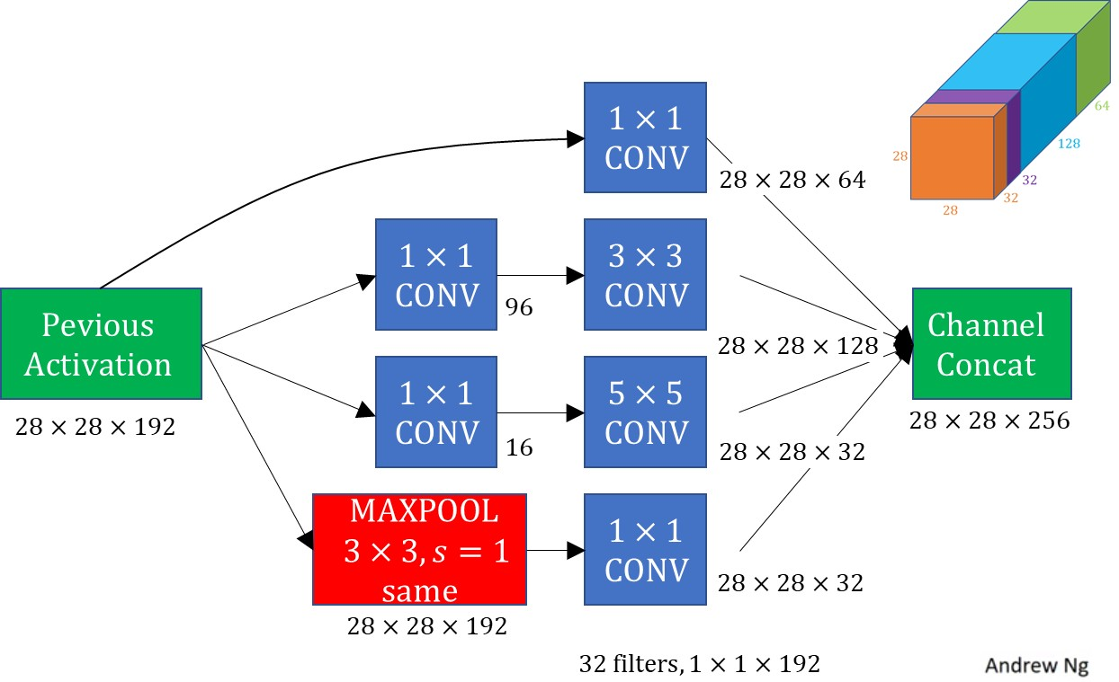
InceptionNet

Slide 43
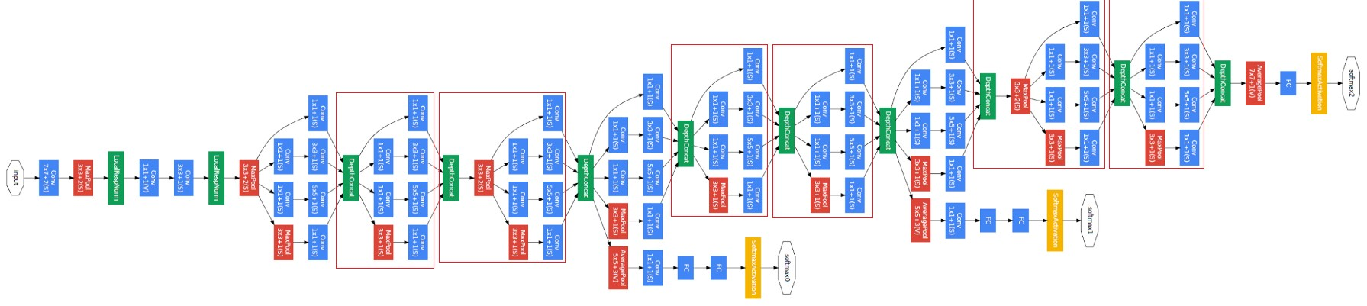
InceptionNet
Szegedy et al. 2014, Going deeper with convolutions.

Slide 44
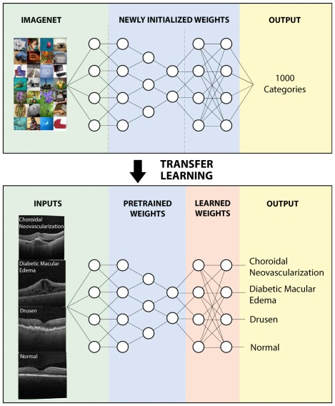
Transfer Learning
Intel Software

Slide 45
Recurrent Neural Network

Slide 46
Neural Networks II
Recurrent Neural Network
Dr. Sugata Ghosal
CSIS Off Campus Faculty
BITS Pilani

Slide 47
In This Session
Overview
Weights in Hidden Layer
Loss Function

Slide 48

Recurrent Neural Networks
time step t
y
_{y}<t>
Networks we used previously: also called feedforward neural networks
Recurrent Neural Network (RNN)
h
_{h}<t>
x
_{x}<t>
Recurrent edge

Slide 49
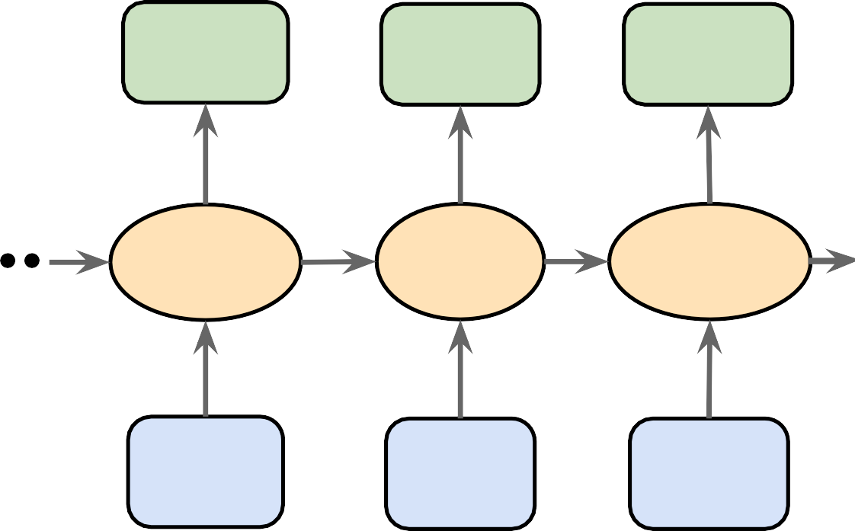
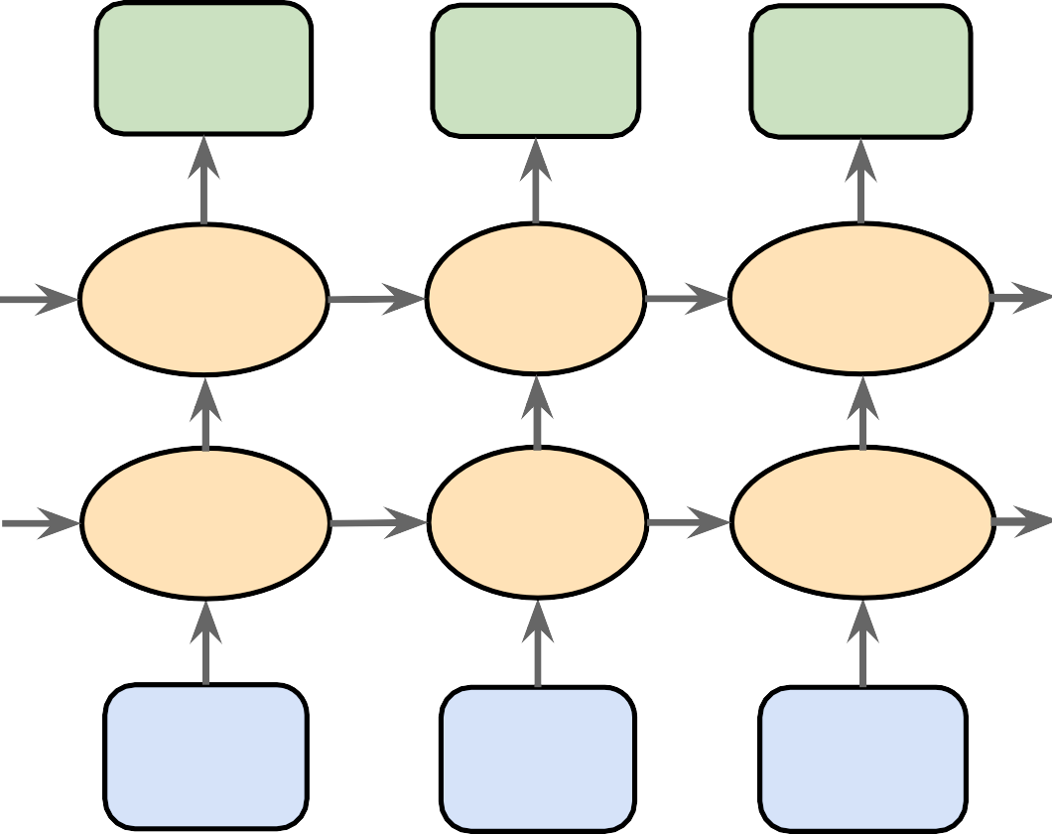
Overview
_{y}<t>
Single layer RNN
_{y}<t-1>
_{y}<t>
_{y}(t+1)
_{h}<t>
Unfold
_{h}<t-1>
_{h}<t>
_{h}(t+1)
_{x}<t>
_{x}<t-1>
_{x}<t>
_{x}(t+1)
_{y}<t>
Multilayer RNN
_{y}<t-1>
_{y}<t>
_{y}(t+1)
_{h}<t>
_{h}<t-1>
_{h}<t>
_{h}(t+1)
2
2
2
2
Unfold
_{h}<t>
_{h}<t-1>
_{h}<t>
_{h}(t+1)
1
1
1
1
_{x}<t>
_{x}<t-1>
_{x}<t>
_{x}(t+1)

Slide 50
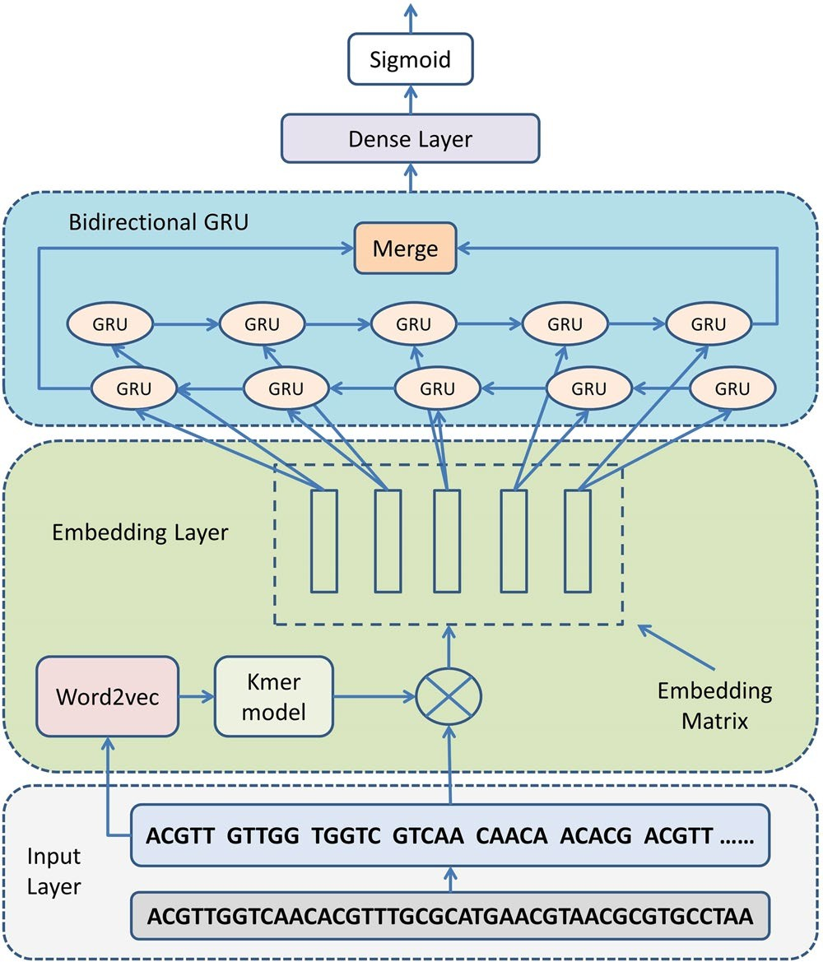
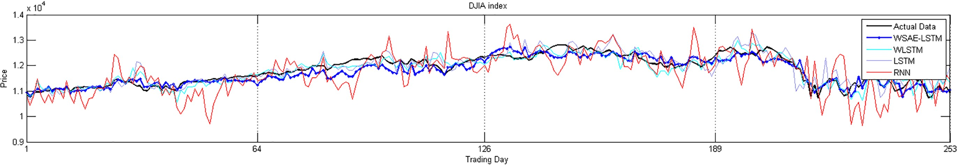
Applications
Text classification
Speech recognition (acoustic modeling)
language translation
...
Stock market predictions
Displays the actual data and the predicted data from the four models for each stock index in Year 1 from 2010.10.01 to 2011.09.30.
Shen, Zhen, Wenzheng Bao, and De-Shuang Huang. "Recurrent Neural Network for Predicting Transcription Factor Binding Sites." Scientific reports 8, no. 1 (2018): 15270.
DNA or (amino acid/protein) sequence modeling

Slide 51
RNN Architecture
Each hidden unit receives 2 inputs
_{y}<t>
Single layer RNN
_{y}<t-1>
_{y}<t> _{y}(t+1)
_{h}<t>
Unfold
_{h}<t-1>
_{h}<t> _{h}(t+1)
_{x}<t>
_{x}<t-1>
_{x}<t>
_{x}(t+1)
_{y}<t>
Multilayer RNN
_{y}<t-1>
_{y}<t>
_{y}(t+1)
_{h}<t>
_{h}<t-1>
_{h}<t>
_{h}(t+1)
2
2
2
2
Unfold
_{h}<t>
_{h}<t-1>
_{h}<t>
_{h}(t+1)
1
1
1
1
_{x}<t>
_{x}<t-1>
_{x}<t>
_{x}(t+1)

Slide 52


Weights in RNN
_{y}<t>
_{y}<t-1>
_{y}<t>
_{y}<t+1>
^{W}h⁼[^{W}hh ^{; W}hx ]
^{W}yh
W
^{W}yh
^{W}yh
^{W}yh
hh
W
W
_{h}<t>
Unfold
_{h}<t-1>
hh
_{h}<t>
hh
_{h}<t+1>
^{W}hx
^{W}hx
^{W}hx
^{W}hx
_{x}<t>
_{x}<t-1>
_{x}<t>
_{x}<t+1>
Net input:
Net input:
_{Z}<t> _{= Wyhh}<t> _{+ by}
Z^{<t>} = W_{hx}x^{<t>} + W_{hh}h^{<t—1>} + b_{h}
y
Output:
_{Y}<t> _{= ay}
h
Activation:
_{H}<t> _{= ah}
$$\left(Z_{y}^{<t>}\right)$$
$$\left(Z_{h}^{<t>}\right)$$

Slide 53
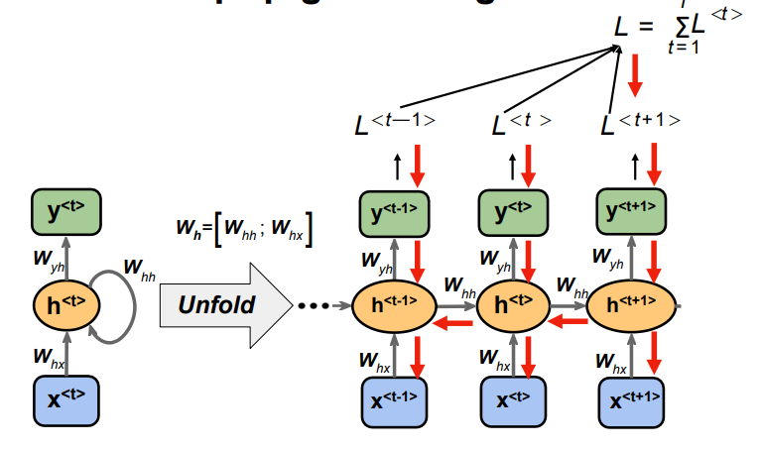
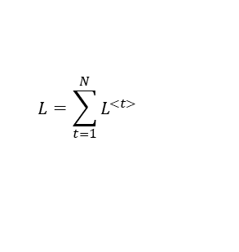
Loss Function in RNN
$$L=\sum_{t=1}^{N}{L^{<t>} }$$

Slide 54
LSTM

Slide 55
Neural Networks II
Long Short Term Memory
Dr. Sugata Ghosal
CSIS Off Campus Faculty
BITS Pilani

Slide 56
In This Session
Traning RNN
Backpropagation Through Time
Issues with BPTT
Long Short term Memory
RNN Variants

Slide 57
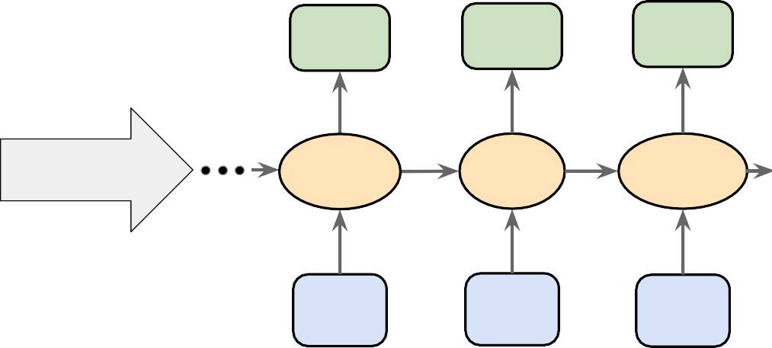
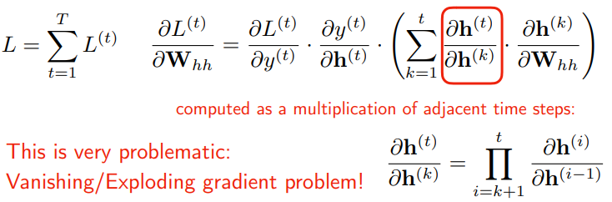
Backpropagation Through Time
_{y}<t>
^{W}h⁼[^{W}hh ^{; W}hx ]
_{y}<t-1>
^{W}yh
_{h}<t-1>
_{y}<t>
^{W}yh
_{h}<t>
_{y}<t+1>
^{W}yh
_{h}<t+1>
^{W}yh
W
hh
W
W
_{h}<t>
Unfold
hh
hh
^{W}hx
^{W}hx
_{x}<t-1>
^{W}hx
_{x}<t>
^{W}hx
_{x}<t+1>
_{x}<t>

Slide 58
Issues with BPTT
Gradient Clipping: set a max value for gradients if they grow to large (solves only exploding gradient problem)
Truncated backpropagation through time (TBPTT)
simply limits the number of time steps the signal can backpropagate each forward pass.
e.g., even if the sequence has 100 elements/steps, we may only backpropagate through 20 or soe
Long short-term memory (LSTM) -- uses a memory cell for modeling long-range dependencies and avoid vanishing gradient problems

Slide 59
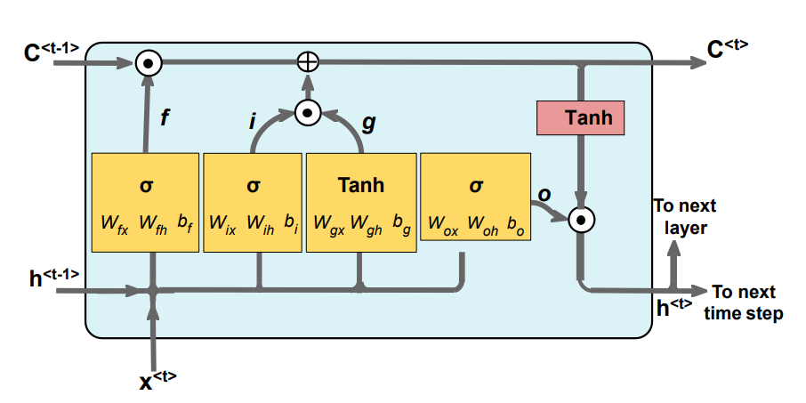
Long Short-term Memory Cell

Slide 60
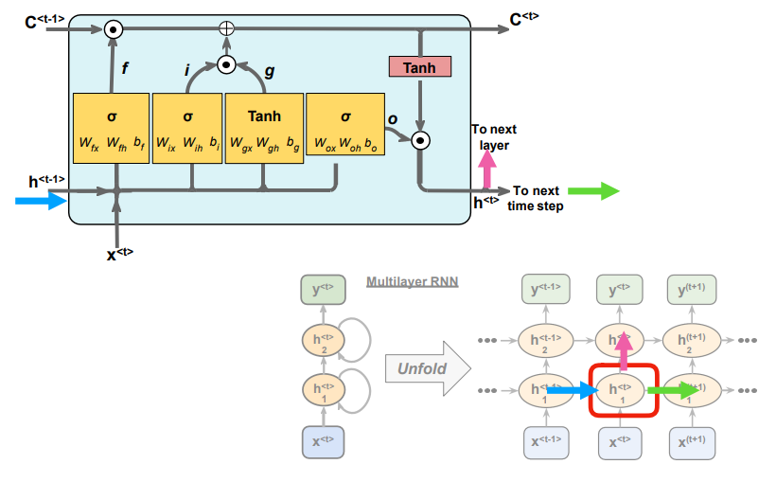
Long Short-term Memory Network

Slide 61
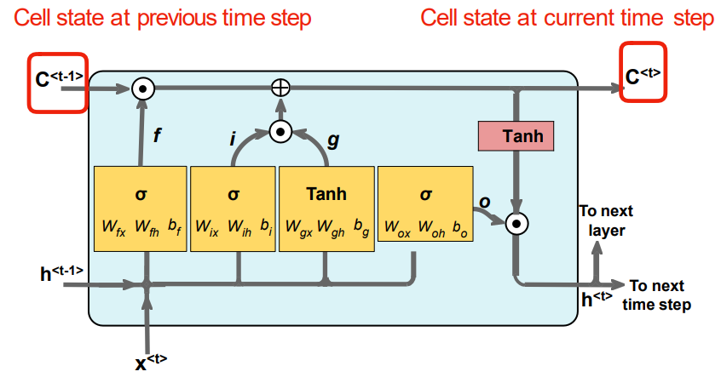
Cell State

Slide 62
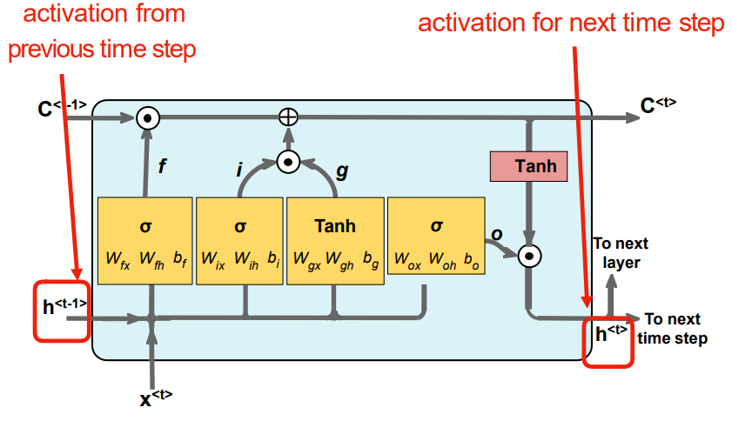
Hidden State

Slide 63
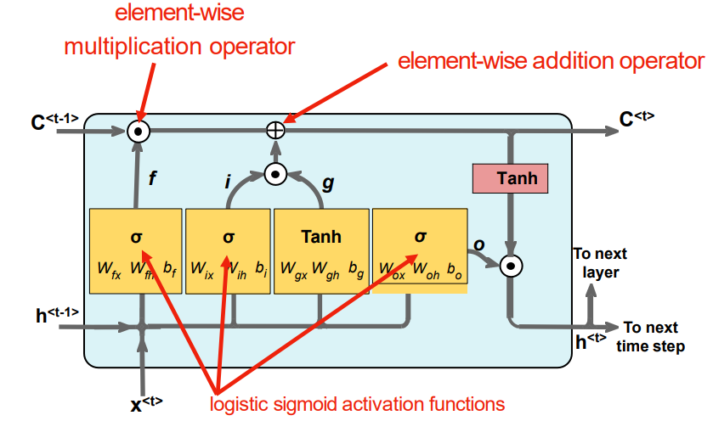
Gates

Slide 64
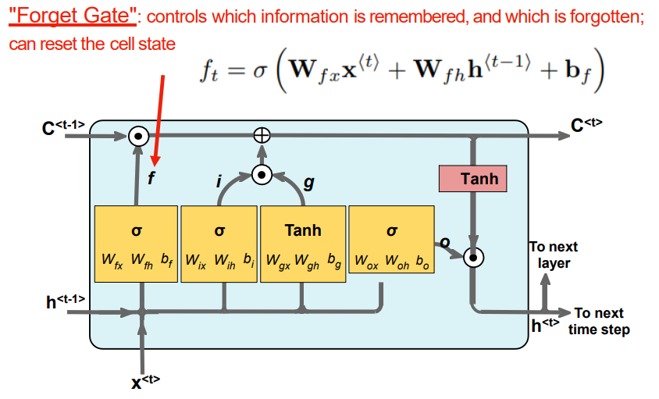
Gates

Slide 65
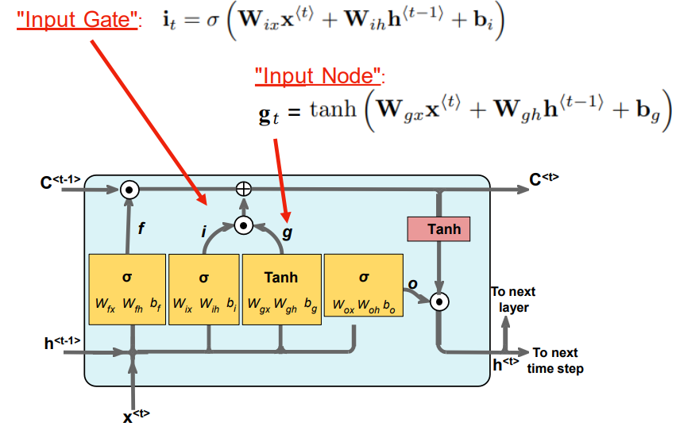
Gates

Slide 66
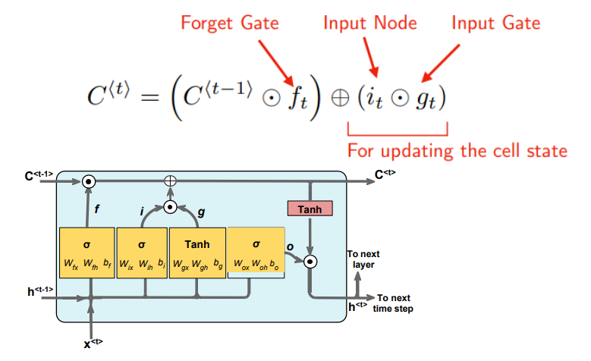
Cell State Calculation

Slide 67
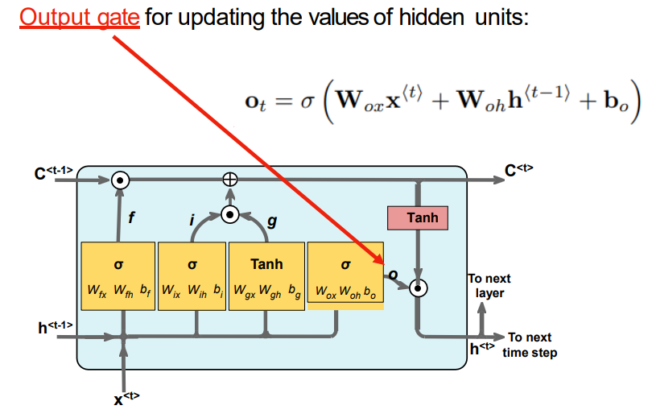

Output Gates

Slide 68
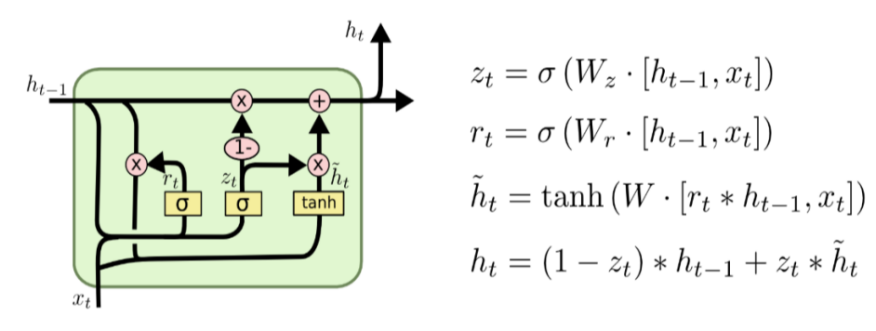
Gated recurrent Unit (GRU)

Slide 69
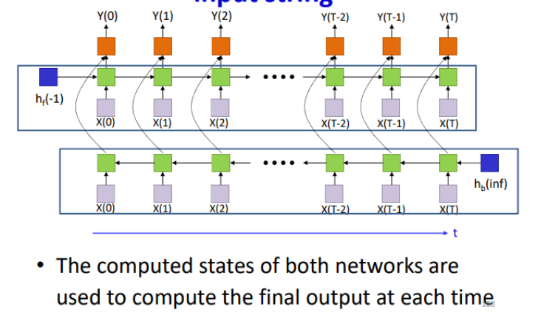
Bidirectional RNN

Slide 70
Applications

Slide 71
Neural Networks II
Applications
Dr. Sugata Ghosal
CSIS Off Campus Faculty
BITS Pilani

Slide 72
In This Session
Sequence Modeling
Generating Names
Language Translation
Data processing for “character” RNN

Slide 73
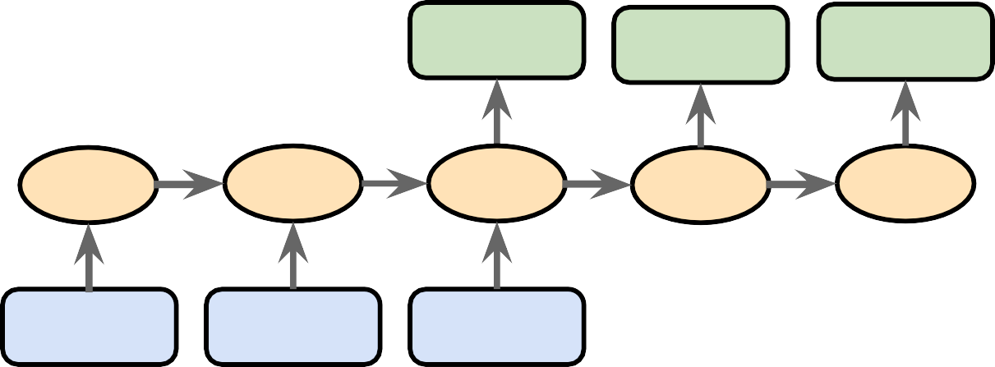
Types of Sequence Modeling
many-to-one
one-to-many
many-to-many
many-to-many
Figure based on:
The Unreasonable Eﬀectiveness of Recurrent Neural Networks by Andrej Karpathy (http://karpathy.github.io/2015/05/21/rnn-eﬀectiveness/)

Slide 74
Many-to-One Modeling
Many-to-one: The input data is a sequence, but the output is a fixed-size vector, not a sequence.
many-to-one
one-to-many
Ex.: sentiment analysis, the input is some text, and the output is a class label.
many-to-many
many-to-many
Figure based on:
The Unreasonable Eﬀectiveness of Recurrent Neural Networks by Andrej Karpathy (http://karpathy.github.io/2015/05/21/rnn-eﬀectiveness/)

Slide 75
One-to-Many Modeling
One-to-many: Input data is in a standard format (not a sequence), the output is a sequence.
Ex.: Image captioning, where the input is an image, the output is a text description of that image
many-to-one
one-to-many
many-to-many
many-to-many
Figure based on:
The Unreasonable Eﬀectiveness of Recurrent Neural Networks by Andrej Karpathy (http://karpathy.github.io/2015/05/21/rnn-eﬀectiveness/)

Slide 76
Many-to-Many Modeling
Many-to-many: Both inputs and outputs are sequences. Can be direct or delayed.
Ex.: Video-captioning, i.e., describing a sequence of images via text (direct).
Translating one language into another (delayed)
many-to-one one-to-many
many-to-many
many-to-many
Figure based on:
The Unreasonable Eﬀectiveness of Recurrent Neural Networks by Andrej Karpathy (http://karpathy.github.io/2015/05/21/rnn-eﬀectiveness/)

Slide 77
Example: One-to-Many
many-to-one
one-to-many
many-to-many
Figure based on:
many-to-many
The Unreasonable Eﬀectiveness of Recurrent Neural Networks by Andrej Karpathy (http://karpathy.github.io/2015/05/21/rnn-eﬀectiveness/)

Slide 78













Generating Names
many-to-many
"training"
many-to-many
"one"
"generating new text"
Generating Names with a Character-level RNN
https://pytorch.org/tutorials/intermediate/char_rnn_generation_tutorial.html

Slide 79









Generating Names
At each time step Softmax output (probability) for each possible"next letter"
For next each input, ignore the prediction but use the
"correct" next letter from the dataset
many-to-many
"training"

Slide 80





Generating Names
To generate new text, now, sample from the softmax outputs and provide the letter as input to the next time step
many-to-many
"one"
Note that this approach works with both Word- and Character-RNNs
"generating new text"

Slide 81

Language Translation
many-to-many
Translation with a Sequence to Sequence Network and Attention (English to French)
https://pytorch.org/tutorials/intermediate/seq2seq_translation_tutorial.html

Slide 82
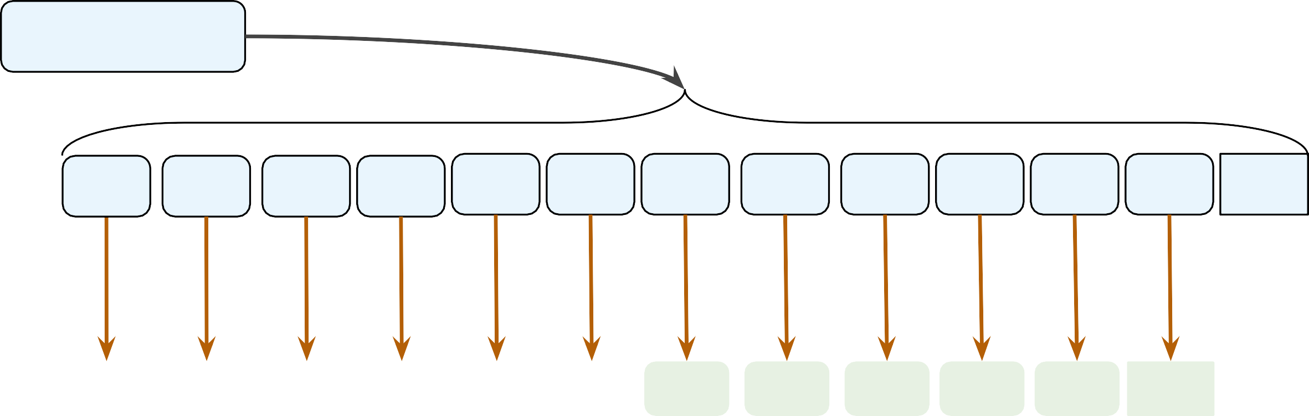
Data Processing for a Character RNN
Step 1: Break up text into characters
Data:
“Hello world!”
Break it into a sequence of
characters
Input Sequence:
‘H’ ‘e’ ‘l’ ‘l’
‘o’
‘ ‘
‘w’ ‘o’ ‘r’ ‘l’ ‘d’
‘!‘
EOS
Predicting next character:
Output Sequence
‘e’ ‘l’ ‘l’ ‘o’ ‘ ‘ ‘w’ ‘o’ ‘r’ ‘l’ ‘d’ ‘!‘
EOS

Slide 83
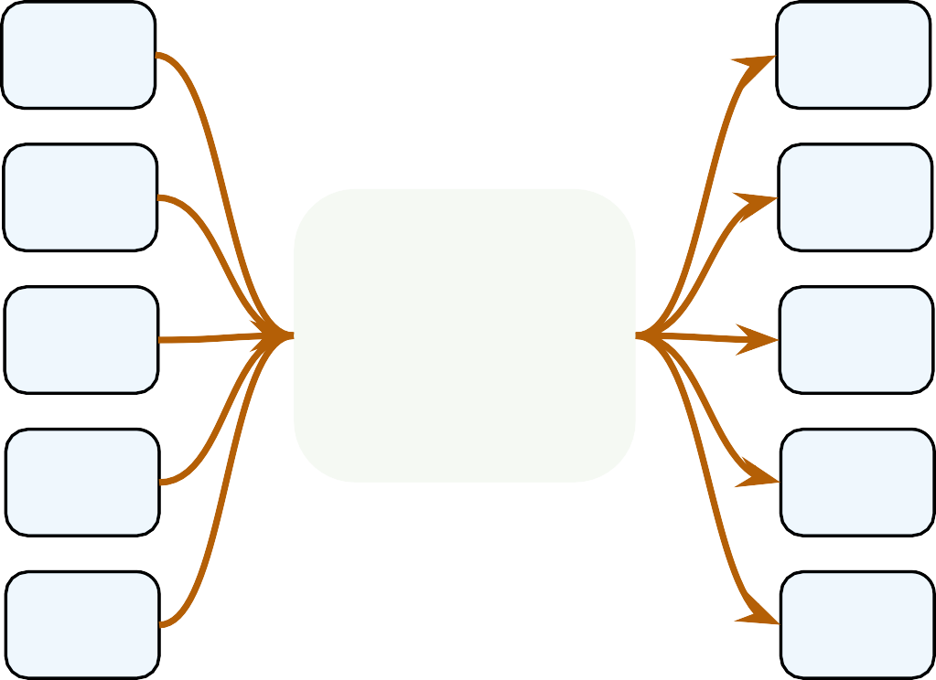

Data Processing for a Character RNN
Step 2: Define Mapping Dictionaries
Mapping characters to integers
Mapping integers to characters
char2int
int2char

Slide 84
Data Processing for a Character RNN
Step 3: Define Inputs and Outputs
Text Corpus
Convert text into a long sequence of integers
Outputs are the characters shifted by 1 position as we want to predict the next character
49, 29, 29, 29, 5, 19, 27, 0, 7, 3, 36, 65, 27,
41, 31, 0, 26, 4, 31, 27, 86, 10, 27, 3, 84, 67,
12, 0, 80, 31, 27, 58, 31, 0, 36, 28, 0, 75, 19,
22, . . . , 52, 84, 19, 31, 0, 22
Create sequences x and y
Sequence x:
49, 29, 29, 29, 5, 19, 27, 0, 7, 3, 36, 65, 27,
41, 31, 0, 26, 4, 31, 27, 86, 10, 27, 3, 84, 67,
12, 0, 80, 31, 27, 58, 31, 0, 36, 28, 0, 75, 19,
22, . . . , 52, 84, 19, 31, 0, 22
Sequence y:
49, 29, 29, 29, 5, 19, 27, 0, 7, 3, 36, 65, 27,
41, 31, 0, 26, 4, 31, 27, 86, 10, 27, 3, 84, 67,
12, 0, 80, 31, 27, 58, 31, 0, 36, 28, 0, 75, 19,
22, . . . , 52, 84, 19, 31, 0, 22
Letters/words can be represented by one-hot encoding
For words, semantic encodings available, e.g., word2vec, GLOVE etc.

Slide 85
FAccT Machine Learning

